Slide 1

CSS Fundamentals
.NET

Slide 2
CSS (Cascading Style Sheets) is a language that describes the style that the browser will give to HTML elements on screen. CSS rulesets are stored in a .css file called a stylesheet.
https://www.w3schools.com/css/css_intro.asp

Slide 3
Preparation
Create a directory, HtmlAndCssPractice, in your personal repo.
Right-Click the directory to open it in VS Code.
Create a .html file, HtmlPractice.html.
In VS Code, download the extension ‘Live Server’ by Ritwick Dey
Reload your VS Code window with CTRL + Shift + P (to open Command Palette) and Type ‘reload window’.
Type ‘doc’ + tab to auto-fill the .html page with the HTML template.
Add <link rel="stylesheet" type="text/css" href="CssPractice.css" /> to the <head> section of your .html just below the <title>.
Create a file, CssPractice.css, in the same folder as your HtmlPractice.html file.
Right-Click on the HtmlPractice.html file in the explorer window and click ‘Open with Live Server’. This will open the .html file in your browser and automatically update the browser any time your HtmlPractice.html file is saved.

Slide 4

CSS – Why? https://www.w3.org/Style/CSS/learning
HTML is not intended to be responsible for style and formatting.
Style Formatting tags were added with HTML 3.2.
Development of large websites became a laborious process with fonts and color information added to every page.
The World Wide Web Consortium (W3C) created CSS to enable separation of concerns between structure and presentation of documents (HTML + CSS).

Slide 5
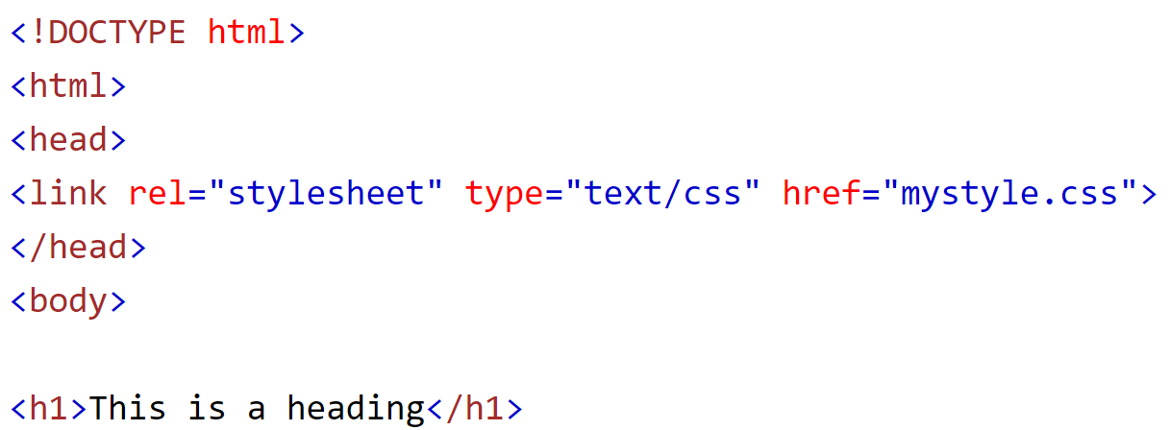
CSS - Adding Styling (1/3) - External https://www.w3schools.com/css/css_howto.asp
Styling Precedence – Inline overrides Internal. Internal overrides External. External overrides Browser default styling.
External .css file (Recommended):
Include a reference to the relative location of the .css file inside a <link> element in the <head> section.
Benefits of External CSS.
Separation of concerns - HTML and CSS are in separate documents, you shouldn’t mix them in the same file.
Reusability - the same stylesheet can be used to style many .html files.
Central location - Change styling in just one place.
Readability - HTML becomes less cluttered, and CSS styling is easier to understand.

Slide 6
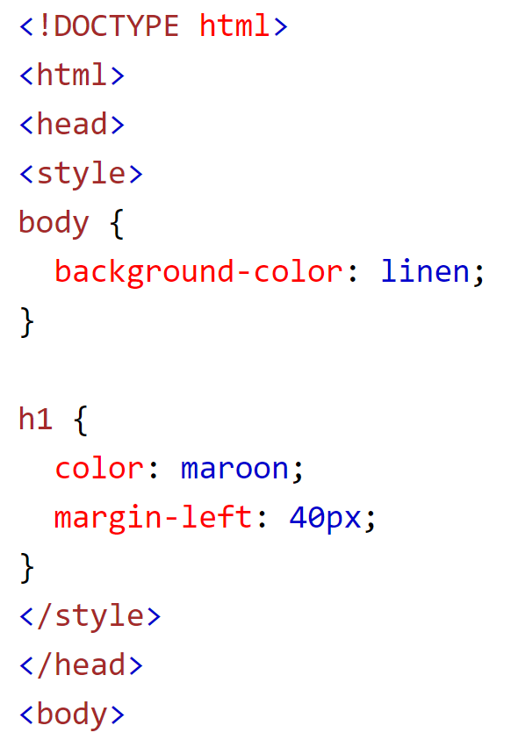
CSS - Adding Styling (2/3) - Internal https://www.w3schools.com/css/css_howto.asp
Internal CSS :
defined inside the <style> element inside the <head> section.

Slide 7
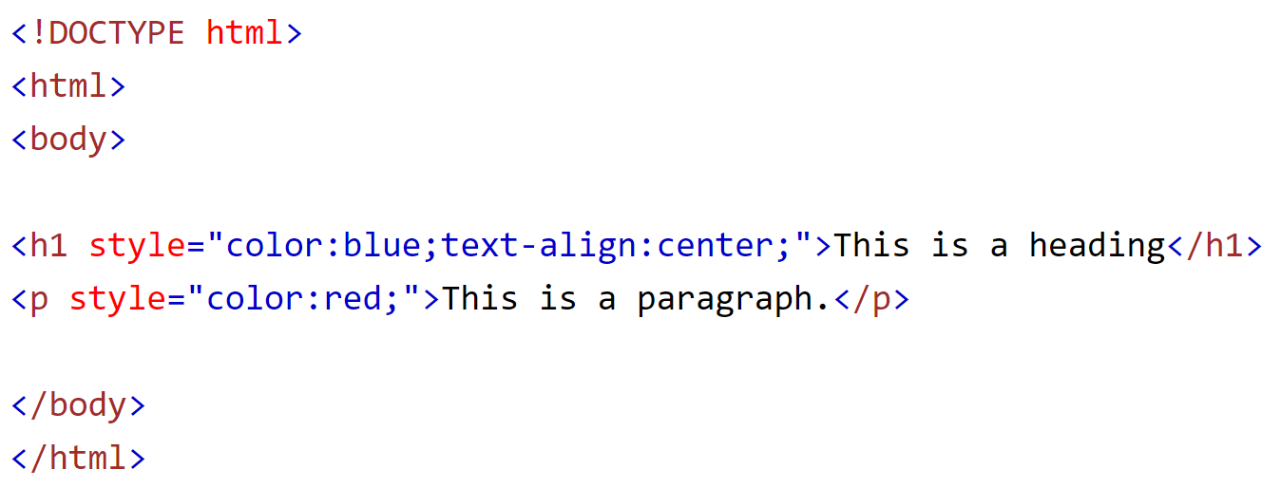
CSS - Adding Styling (3/3) - Inline https://www.w3schools.com/css/css_howto.asp
Inline CSS :
used to apply a unique style to a single element,
add a style attribute inside the relevant elements opening tag.

Slide 8
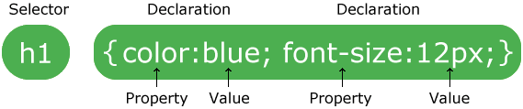
CSS – Syntax https://www.w3schools.com/css/css_syntax.asp
A rule or "rule set" is a statement that tells browsers how to render particular elements on an HTML page.
The selector points to the HTML element you want to style.
The declaration block is bounded by ‘{ }‘, contains declarations separated by ‘;’.
Each declaration includes a CSS property name and a value, separated by a colon.

Slide 9
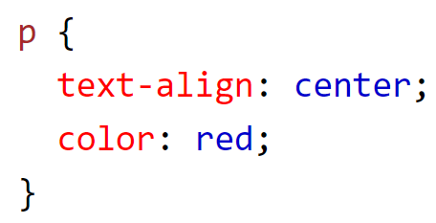
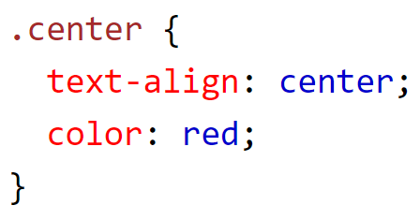
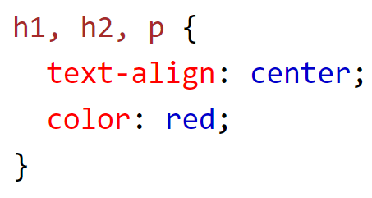
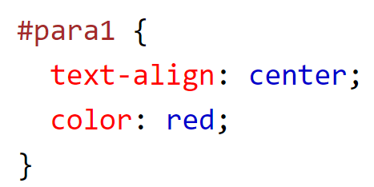
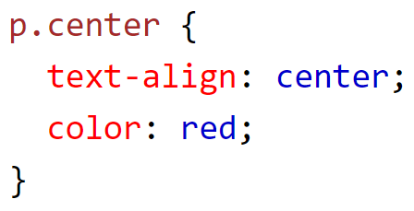
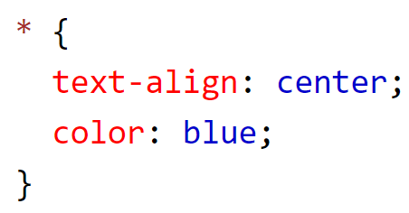
CSS – Selector https://www.w3schools.com/css/css_selectors.asp
Selector Type | Example RuleSet | Description
element Selector | div { declarations } | Selects 1 or more HTML elements based on the tag name.
id Selector | #id1 { declarations } | Selects HTML elements based on the id attribute name.
class Selector | .center { declarations } | Selects HTML elements based on the class attribute name.
Universal Selector | * { declarations } | Selects all HTML elements on the page.
Selector List | h1, h2, p { declarations } | Selects all indicated HTML tags in the document.
Concatenation | p.center { declarations } | Selects all center class elements inside a <p> element.

Slide 10
CSS – Pseudo-Selector https://www.w3schools.com/css/css_pseudo_classes.asp https://developer.mozilla.org/en-US/docs/Learn/CSS/Building_blocks/Selectors/Pseudo-classes_and_pseudo-elements
There are two types of Pseudo-Selectors.
Pseudo-Class Selectors | Pseudo-Element Selectors
Used to define a special state of an element, like displaying a visited link differently or changing an elements color when the mouse hovers over it. | A CSS pseudo-element is used to style specified parts of an element, like the first letter (or line) of an element.

Slide 11
CSS – Pseudo Class Selectors https://www.w3schools.com/css/css_pseudo_classes.asp https://developer.mozilla.org/en-US/docs/Web/CSS/Pseudo-classes
A pseudo-class applies styling only when an element is in a certain state. It is a colon and keyword appended to a selector:
when the mouse hovers over the element
when a checkbox is checked.
Use a colon (:) in front of the pseudo-class name. These are just a few of the over 30 pseudo-classes available.
p.myClass:active
a.myClass:visited
a:checked
a.myClass:disabled
div:first
a.myClass:nth-child(n)
a.myClass:hover

Slide 12
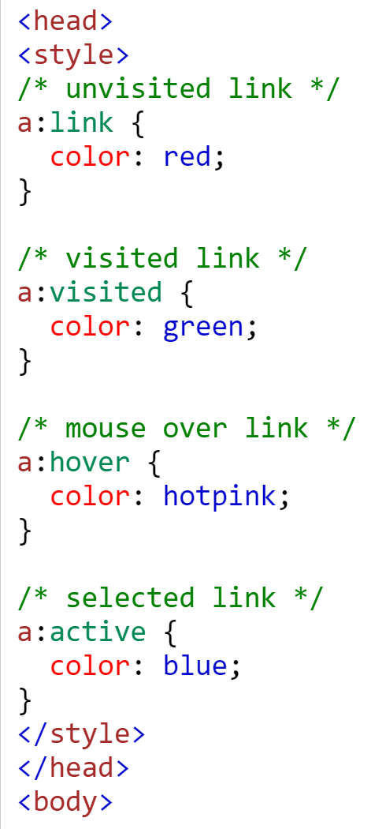


CSS – Pseudo Class Examples https://www.w3schools.com/css/css_pseudo_classes.asp
This is a link
This link was clicked
The mouse is over this link
This link is selected

Slide 13
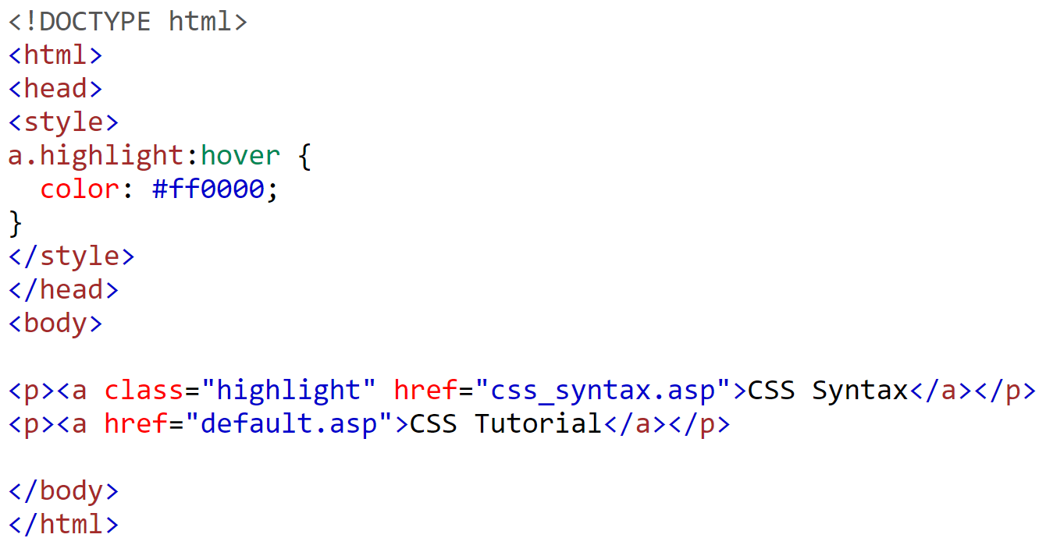
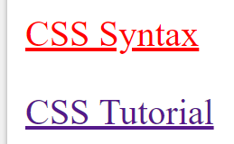
CSS – Pseudo Classes with HTML Classes https://www.w3schools.com/css/css_pseudo_classes.asp
Pseudo Classes can be placed on HTML elements to be more specific as to which elements you want the style.

Slide 14
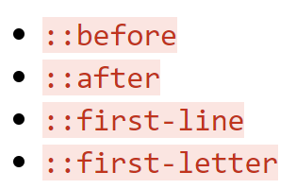
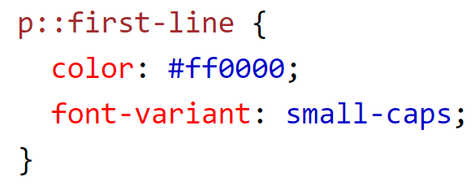
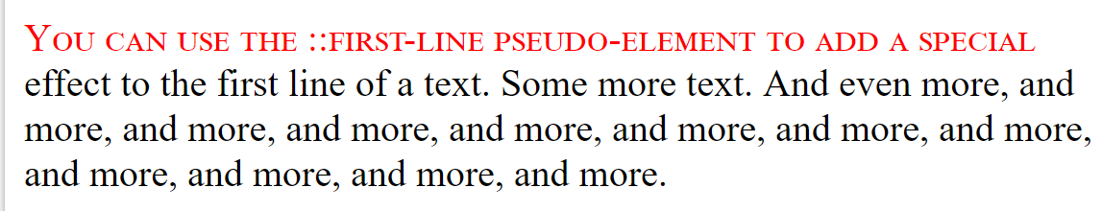
CSS – Pseudo Elements https://www.w3schools.com/css/css_pseudo_elements.asp
A CSS pseudo-element is used to style specified parts of an element.
To use it, place two colons (::) between the element and the pseudo element.
This example formats the first line of the text in all <p> elements:
Pseudo-Elements allow you to style just the first letter (or line) of an element or insert other content before or after the content of an element
<p>You can use the ::first-line pseudo-element to add a special effect to the first line of a text. Some more text. And even more, and more, and more, etc...</p>

Slide 15
CSS – Chaining Pseudo Elements https://www.w3schools.com/css/css_pseudo_elements.asp
You can combine a pseudo class and a pseudo element to combine the two effects.
If you wanted to you could chain the :first-child and ::first-line selectors together.
article p:first-child::first-line {
font-size: 120%;
font-weight: bold;
}
The above code will make the first line of the first paragraph bold

Slide 16
CSS – Combinators https://www.w3schools.com/css/css_combinators.asp
The selector part of a CSS RuleSet can contain more than one selector. Between the selectors, we can a combinator. There are four different combinators. A combinator describes the relationship between two selectors.
Selector | Symbol | Description
descendant selector | (space) p .myClass{ ruleset} | Matches any descendant element (nested inside) of a specified element. This includes grandchildren, etc.
child selector | > | Selects only elements that are the immediate descendants (children) of an element.
Adjacent (next) sibling selector | + | Selects the next (sibling) element only if the sibling occurs immediately after this element.
general sibling selector | ~ | Selects all sibling elements that follow this element.

Slide 17
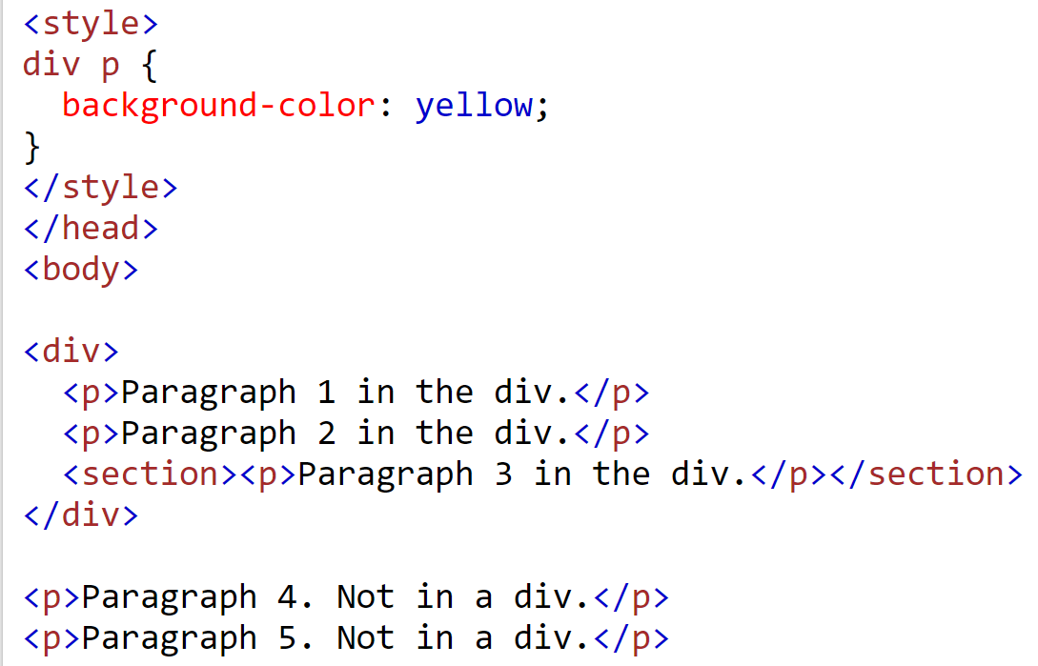
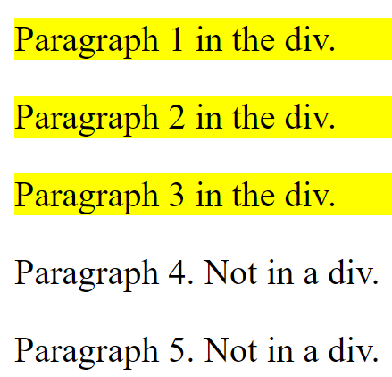
CSS Combinator - Descendent https://www.w3schools.com/css/css_combinators.asp
Descendent means any <p> element nested inside a <div> to unlimited depth.

Slide 18
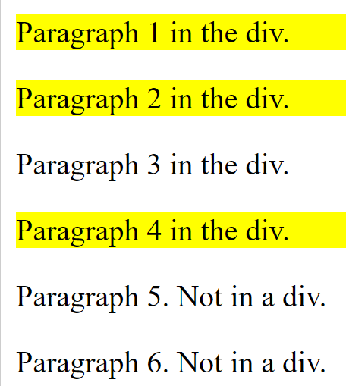
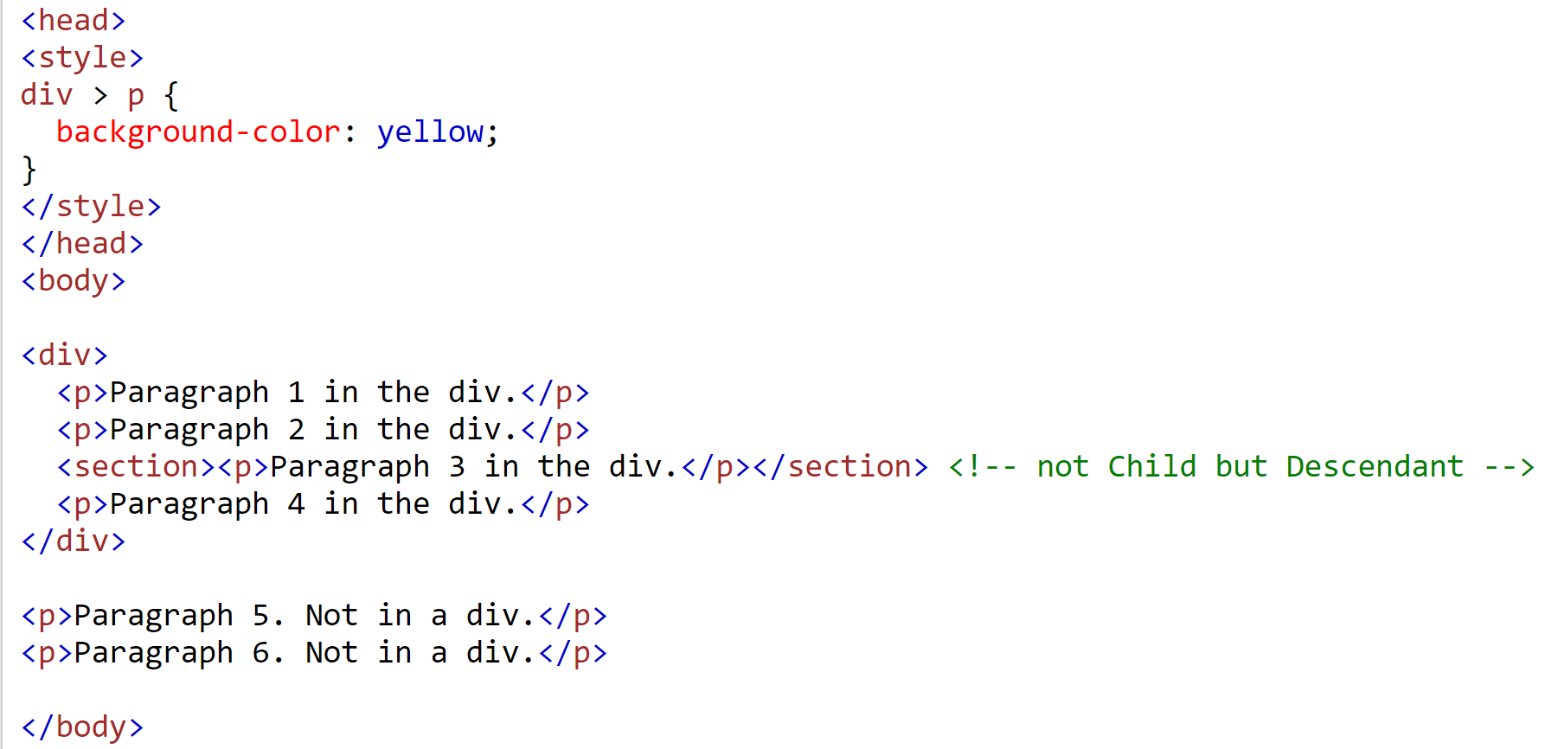
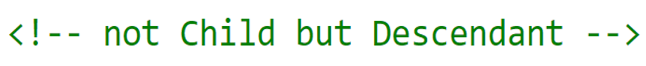
CSS Combinators Example - Child https://www.w3schools.com/css/css_combinators.asp
Child means any <p> element inside the <div> but only one level deep. This means grandchild elements are not styled.

Slide 19
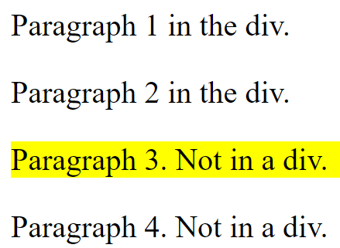
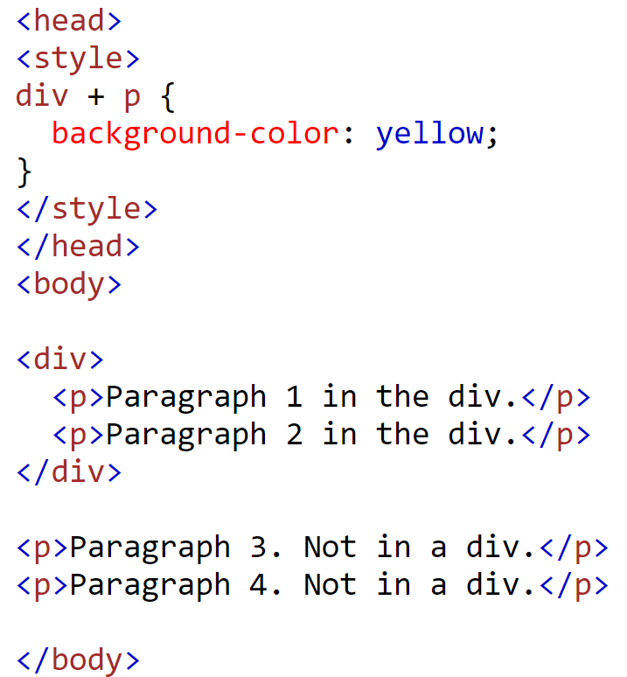
CSS Combinators – Adjacent Sibling https://www.w3schools.com/css/css_combinators.asp
Adjacent Sibling means the first <p> sibling immediately following a div.

Slide 20
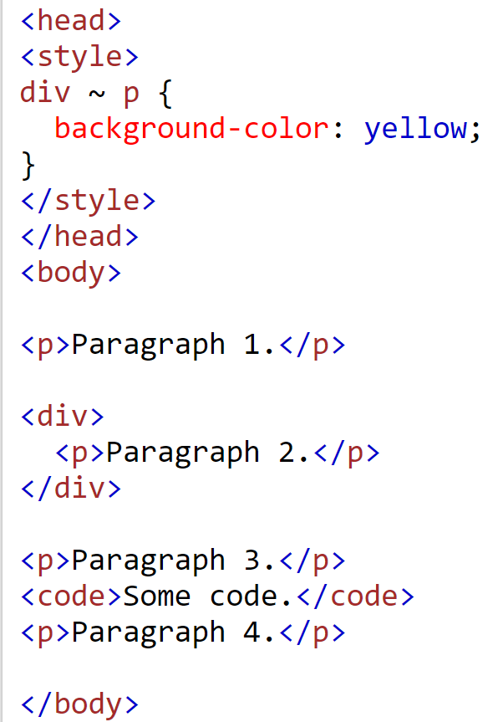
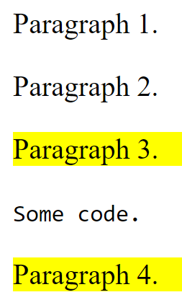
CSS Combinators Example – General Sibling https://www.w3schools.com/css/css_combinators.asp
In this example, General Sibling means all <p> siblings occurring after the div.

Slide 21
CSS – Units of measurement https://developer.mozilla.org/en-US/docs/Learn/CSS/Building_blocks/Values_and_units
There are two ways to give measurement in CSS. Both Absolute and Relative measurements have appropriate uses.
Absolute Measurements
px | pixels
mm | millimeters
cm | centimeters
in | inches
pt | points(1/72 of an inch)
pc | picas (12 points)
Relative Measurements
% | percentage relative to parent element's width
em | 1em is the same as the font size( scales with it) of the current element
rem | stands for "root em" and works the same except refers to the base font size
vh, vw | these are 1/100th of the height and width of the viewport, respectively
Most common

Slide 22
CSS – Colors https://developer.mozilla.org/en-US/docs/Web/HTML/Applying_color
There are four ways color can be set in CSS.
How to Define Colors
keywords | ‘red’, ‘blue’, ‘aquamarine’, etc (Ex. Color:blue;)
hex value | The # sign followed by six hex numbers (0-F) with each pair representing rgb values for up to 256 different values of each. (Ex. Color:#ff0000;)
rgb(r,g,b) | This function specifies values from 0 to 255 for red (r), green (g), and blue (b). Ex. Color:rgb(224,176,255);. There is an optional alpha (transparency) value, but this isn’t used much. (rgba(224,176,255, .5))
hsl(h,s,l) | This function to specifies hue, saturation, and lightness values, 0 to 255, to define a color. (Ex. Color:hsl(240,100%,50%);). There is an optional alpha (transparency) value, but this isn’t used much. (Color:hsla(240,100%,50%, .4);)

Slide 23
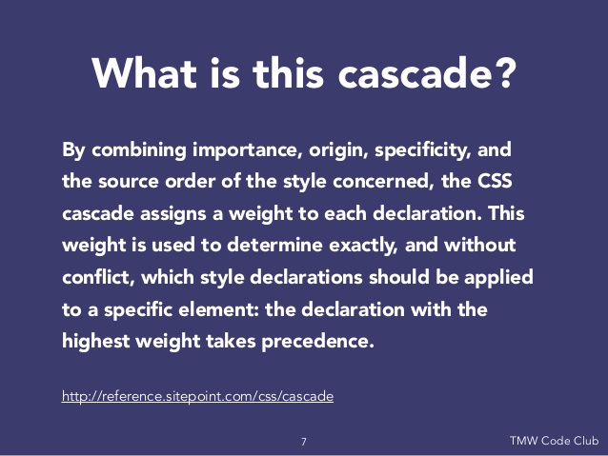
CSS - Rule Set Conflicts https://www.w3.org/Style/LieBos2e/enter/Overview.en.html
What happens if two CSS rulesets conflict with each other?
The order that selectors are chosen for styling depends on three things:
Importance
Specificity
Source order

Slide 24
CSS – Specificity (1/4) https://developer.mozilla.org/en-US/docs/Web/CSS/Specificity
Specificity is the means by which browsers decide which CSS property values are chosen to style an element.
Specificity is a weight given to each RuleSet. When multiple RuleSets have the same weight, the last occurring RuleSet wins.
A Ruleset with a more specific selector combination wins over a less specific combination.
Specificity only comes into play when the same element is targeted by multiple declarations.
Directly targeted elements will always take precedence over inherited styling.
div#test span
{ color: green; }
div span
{ color: blue; }
span
{ color: red; }
<div id="test">
<span>
Text
</span>
</div>
Although, the rule for blue is more specific than the rule for red, the rule for green is the most specific and will be applied. RuleSet order does not matter.

Slide 25
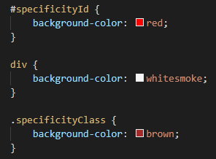
CSS – Specificity of Selectors (2/4) https://developer.mozilla.org/en-US/docs/Web/CSS/Specificity
Selectors by order of increasing specificity:
Type selectors (e.g., h1) and pseudo-elements (e.g., ::before).
Class selectors (e.g., .example), attributes selectors (e.g., type="radio") and pseudo-classes (e.g., :hover).
ID selectors (e.g., #example).
The following CSS styles, Which rule will be applied?
div { color: red; } /* least specific - won't be applied */
#yellow { color: yellow; } /* most specific - will be applied */
.green { color: green; } /* in the middle - won't be applied */
<div>
<p class=“specificityClass”
id=“specificityId”
style=“background-color:lightgreen;”
>This is a specificity example</p>
</div>

Slide 26
CSS – Specificity and Source Order (3/4) https://developer.mozilla.org/en-US/docs/Web/CSS/Specificity
If two selectors have equal importance level and specificity, then the latter rule wins over earlier one.
For example:
div { color: blue; } /* This comes first, will lose */
div { color: red; } /* comes last, so is applied */
Internal styling wins over external styling.
<div>
<p class=“specificityClass”
id=“specificityId”
style=“background-color:lightgreen;”>
This is a specificity example</p>
</div>

Slide 27
CSS – Specificity and !important (4/4) https://developer.mozilla.org/en-US/docs/Web/CSS/Specificity
The !important flag can be used to raise a RuleSet’s specificity. This ensures that a style always gets applied.
div { color: red !important; } <!- - always applied - ->
The only way to override an !important flag is to apply another !important flag on a selector with the same specificity later in the document or on a selector with greater specificity.
*!important is not best practice. Use Specificity instead.

Slide 28
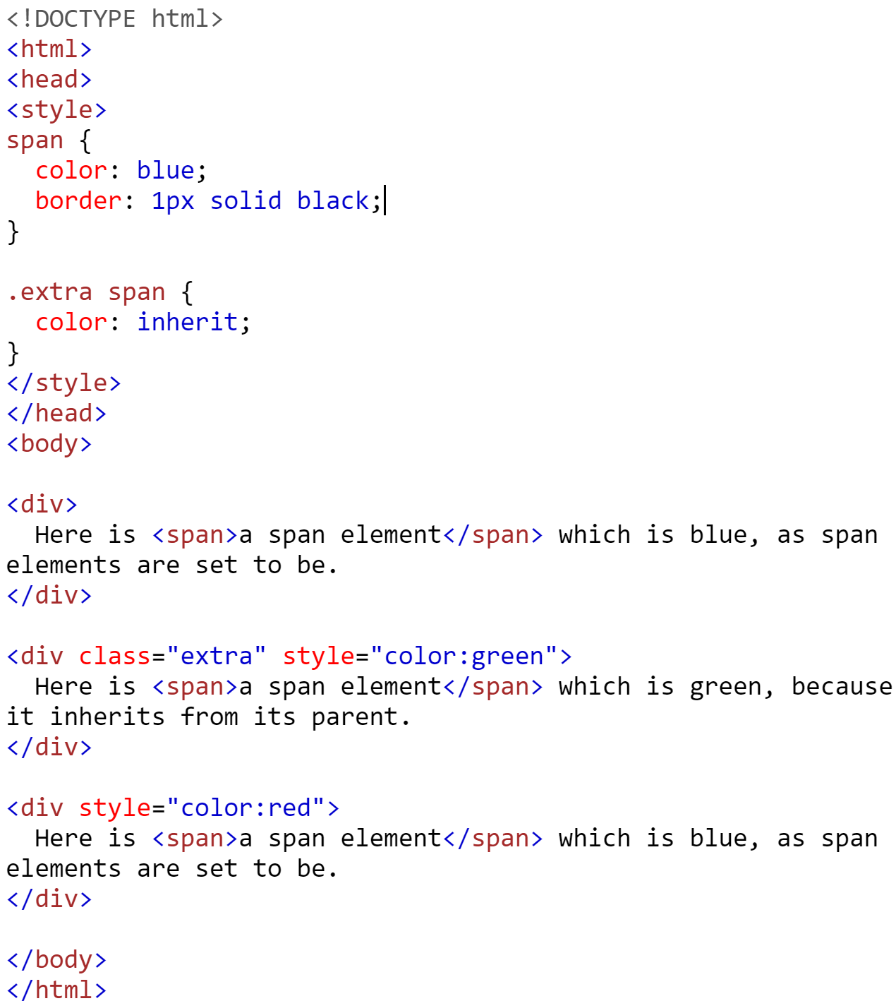
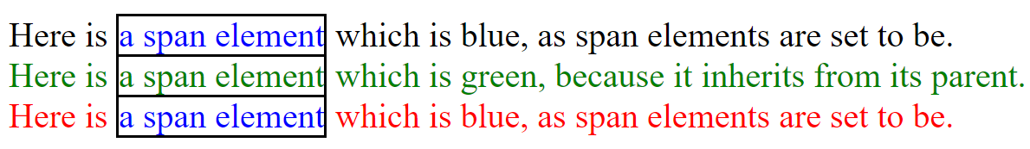
CSS –Inherit Keyword https://www.w3schools.com/cssref/css_inherit.asp https://developer.mozilla.org/en-US/docs/Learn/CSS/Building_blocks/Cascade_and_inheritance https://developer.mozilla.org/en-US/docs/Web/CSS/inheritance
The width, margin, padding, and border of an element is not automatically inherited from its parent. Some elements inherit but others do not.
The inherit keyword specifies that a property shall inherit its styling from its parent element.
The inherit keyword can be used for any CSS property, and on any HTML element.

Slide 29
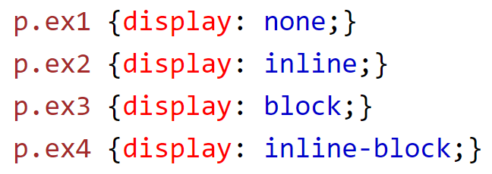
CSS – display Property https://www.w3schools.com/cssref/pr_class_display.asp
The display property defines the display type of an element. This overrides whatever default display values the property has.
display: none removes the element from the page completely.
visibility: hidden means that the tag is still given space on the page but isn't seen.
inline - Display on the same line as other elements.
block - Start on a new line.
flex - Make the element a flexbox.
none - Do not display the element at all.

Slide 30
CSS – position Property (1/2) https://www.w3schools.com/cssref/pr_class_position.asp
The position property is an important property related to the layout of a webpage. It governs the flow of elements. You can even take elements out of the normal flow of the page to appear where you want.
Important position property values:
static – (default) the element is placed in the normal document flow
relative - the element occurs in its normal place, but can be moved around with top, bottom, left, and right properties
absolute - removes the element from the normal flow of the document, fixes it in place relative to the html element or nearest positioned ancestor
fixed - fixes element in place relative to browser window.
sticky - hybrid between relative and fixed, allowing relative positioning until scrolled to a ‘threshold’ point

Slide 31
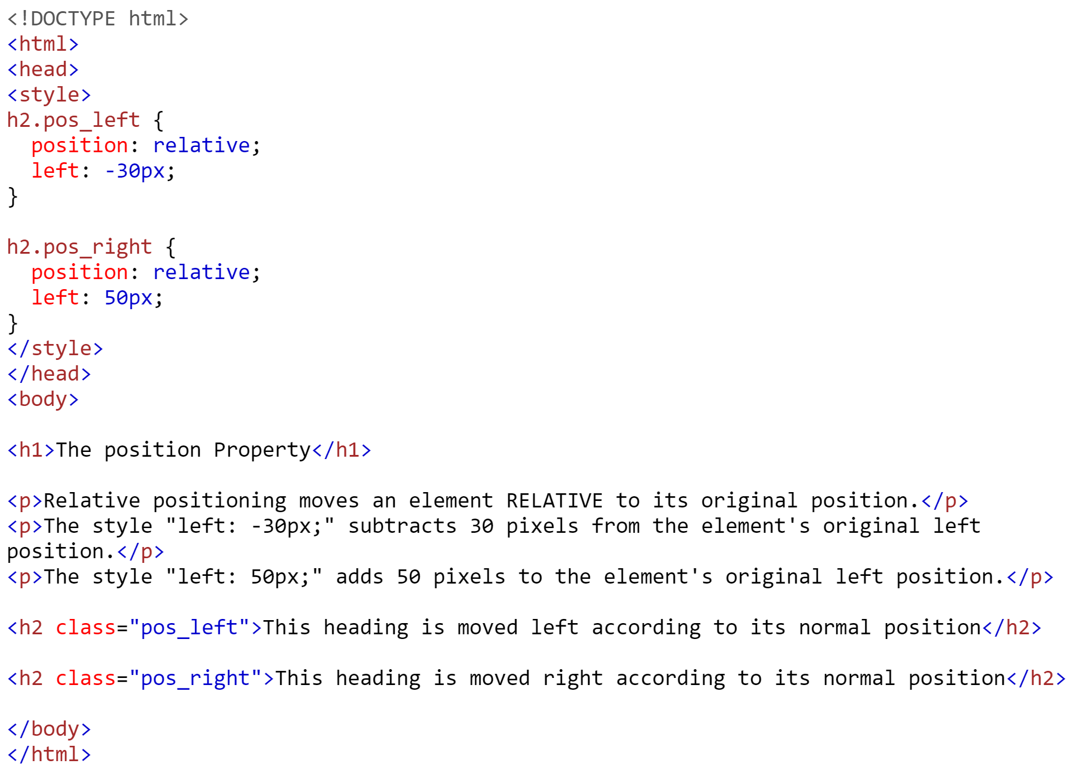
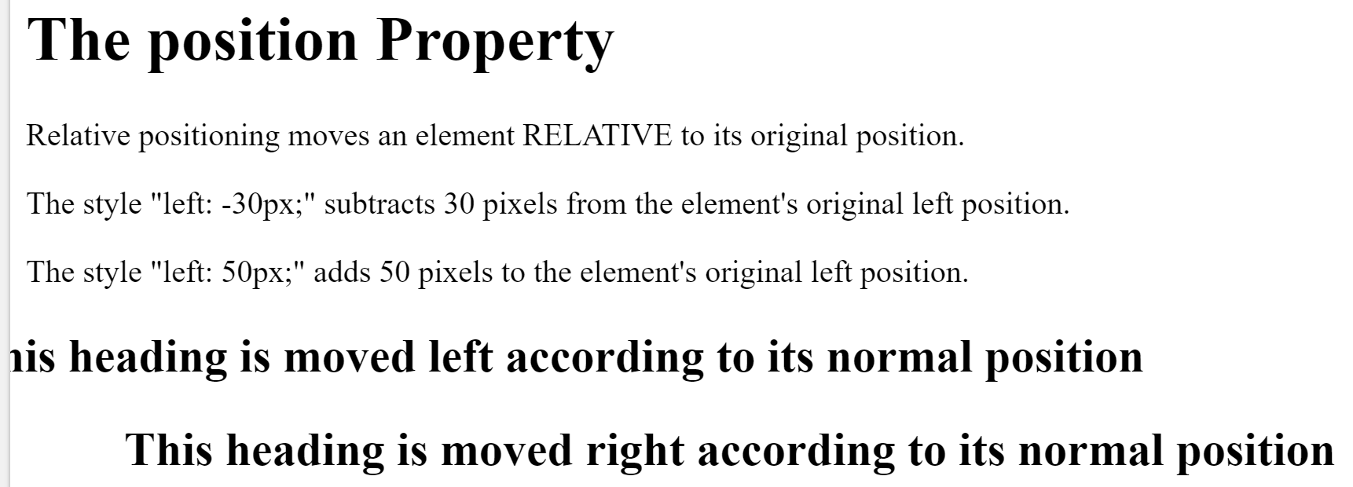
CSS – position Property (2/2) https://www.w3schools.com/cssref/pr_class_position.asp

Slide 32

CSS - Responsive Web Design https://developer.mozilla.org/en-US/docs/Tools/Responsive_Design_Mode
Responsive Web Design is a way of designing web pages so that they render well on any window, screen, or device size. RWD has become increasingly important due to the share of internet traffic conducted from cell phones and devices. There are a few ways to design web pages to change based on the size of the screen.
Fluid grid systems make your element containers sized with relative units like percentages instead of absolute units
Flexible images are sized relatively to prevent rendering outside their container.
Media queries change CSS based on the window size

Slide 33
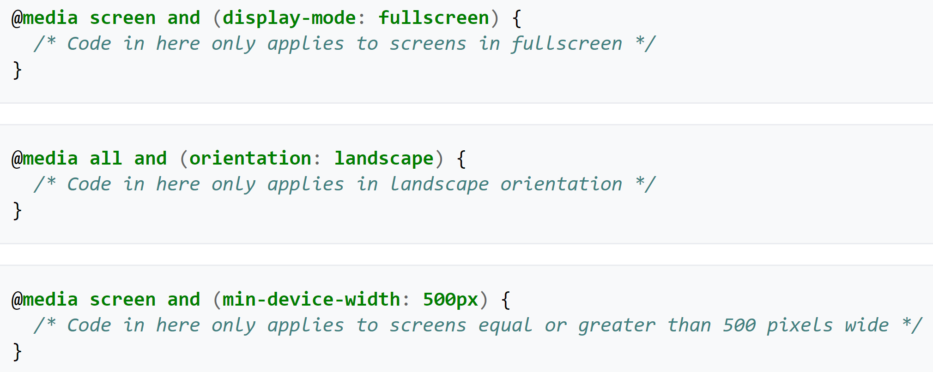
CSS - Media Queries https://en.wikipedia.org/wiki/Media_queries https://developer.mozilla.org/en-US/docs/Web/CSS/Media_Queries
Media queries are a way of adapting the display of CSS for different screen sizes. They can be used to respond to different media types and features. An example of the syntax is shown below:
A media type can be declared in the head of an HTML document using the "media" attribute inside of a <link> element. The value of the "media" attribute specifies how the linked document will be displayed on each device.

Slide 34
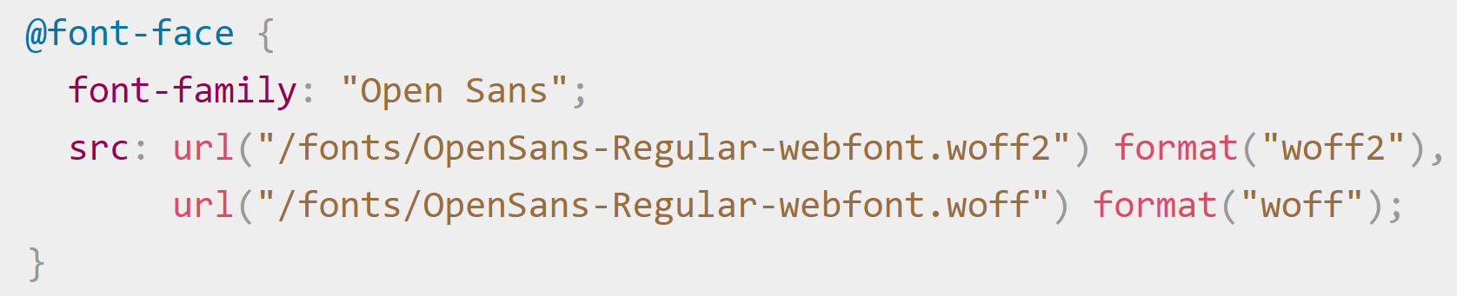
CSS – ‘at-rules’ https://developer.mozilla.org/en-US/docs/Web/CSS/At-rule
A media query is one type of @rule. @rule’s tell CSS what to do in some certain situation.
The most important @rule’s are:
@media - used for media queries
@font-face - used for defining a custom font
@keyframes - used for animations in CSS

Slide 35
Details about CSS3 https://developer.mozilla.org/en-US/docs/Web/CSS https://makeawebsitehub.com/css3-mega-cheat-sheet/
CSS Level 2 needed 9 years to reach the “Recommendation” status. This was because a few secondary features held back the whole specification.
In order to accelerate the standardization of non-problematic features, the CSS Working Group of the W3C divided CSS in smaller components called modules.
Each of these modules is now an independent part of the language and moves towards standardization at its own pace.
While some modules are already W3C Recommendations, others are still early working drafts. New modules are added when new needs are identified.
CSS3 is still evolving but some features are available such as:
rounded corners, shadows, gradients, transitions and animations, flexbox layouts

